Slide 1
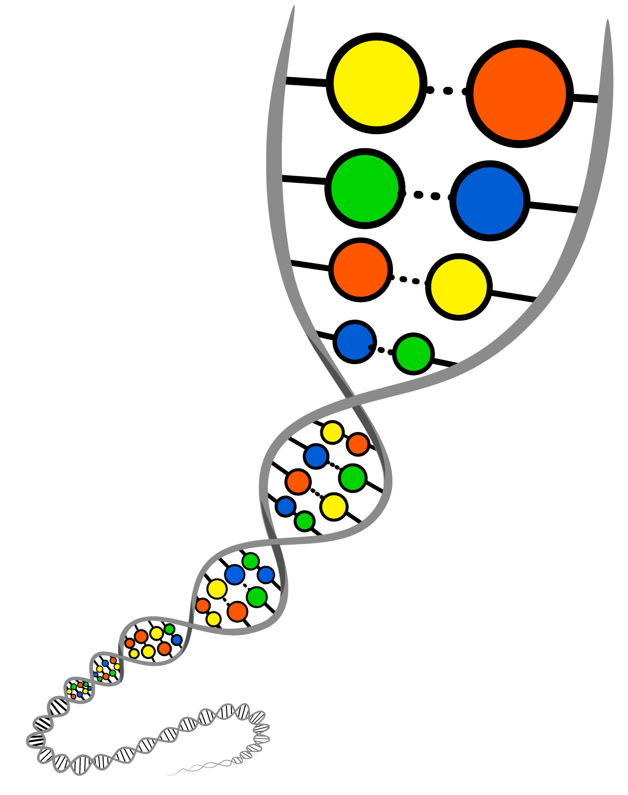
Monster Inheritance
DNA, traits, and inheritance

Slide 2
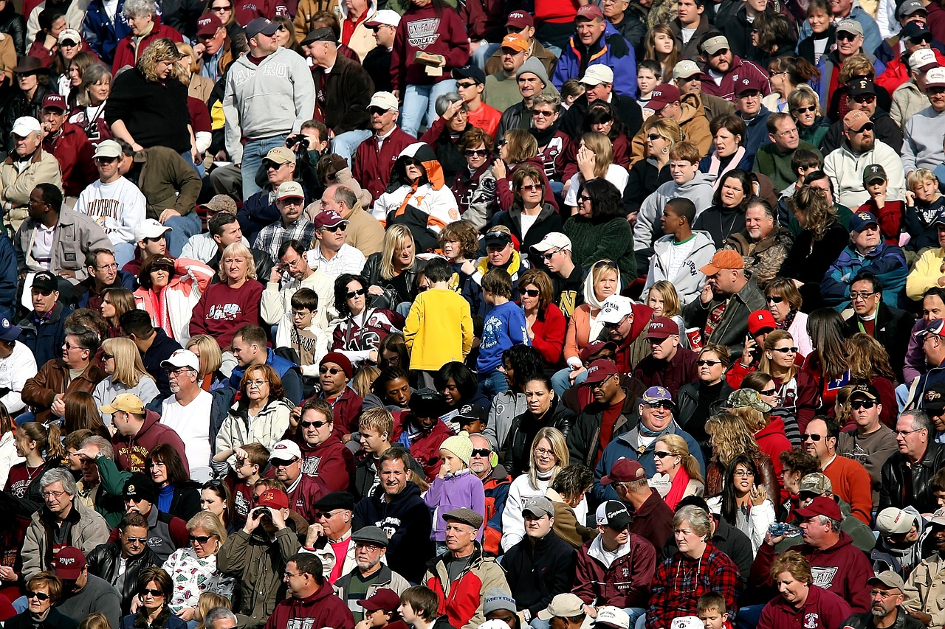
What about you is unique? What’s similar?
Notes:
Have students discuss with their group what they all have in common and what is unique about themselves and each other. Remind them this is not an opportunity to insult each other but an opportunity to have a scientific discussion.
Discussion prompts
Some things to suggest in case a group is having trouble:
Some things that often differ between people are hair color, eye color, height, dimples, freckles, the ability to roll their tongue, thinking cilantro tastes like soap.
Some things that are often the same between people are number of fingers, having body hair, having fingernails, the inability to lick your own elbow (be careful with this one, they will try it)
A group may all share a more variable trait though
“Crowd of people crowd football fans” by KeithJJ. Licensed under Pixabay Content license - https://pixabay.com/photos/crowd-of-people-crowd-football-fans-1488213/

Slide 3
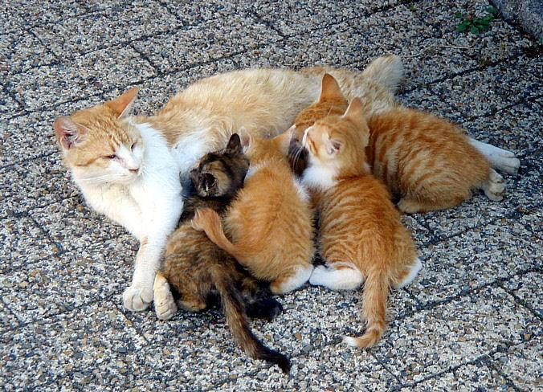
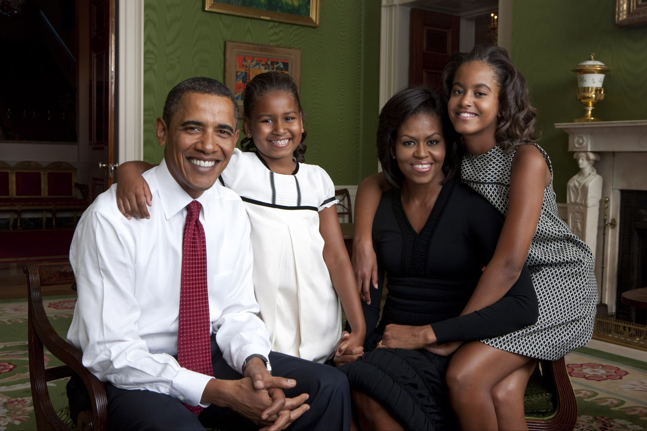
Why do children often look like their relatives?
Notes:
Have students discuss this question in table groups
Discussion prompt:
What things do kids tend to get from their parents? What do those things have in common?
Have you heard anything about how companies like 23 and Me can determine where you are from?
“A litter of kittens suckling their mother” by Laitche- Own Work. Licensed under Public Domain via Wikimedia Commons - https://commons.wikimedia.org/wiki/File:Laitche-P013.jpg
“Obama family portrait in the Green Room” by Annie Leibovitz / Released by White House Photo Office. Licensed under Public Domain via Wikimedia Commons - https://commons.wikimedia.org/wiki/File:Obama_family_portrait_in_the_Green_Room.jpg

Slide 4
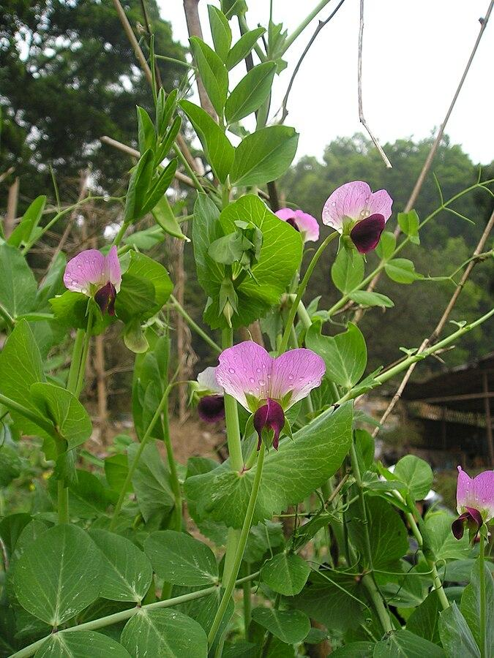
Predict - How tall will pea plants grow?
Farmer Joe grows two types of pea plants, one type that grows tall and another type that is short. One year he decides to mix the two types of pea plants and allows them to breed. How tall do you think the pea plants that he produces will be?
Notes:
Once again, have students discuss in table groups.
Extra context: Pea plants were chosen for this discussion very specifically because one of the causes of dwarfism in them is controlled under a simple 1 gene inheritance model. This experiment is similar to the first generation of one of Mendel’s experiments. The correct answer is that 100% of the pea plants would be tall. Your students may not get that, because that is not the most intuitive answer. Along with distinguishing between acquired and inherited traits, the main goal of this lesson is to teach students the intuitive blending model is not correct. The most likely answer your students will give is that they will be average/medium/somewhere in between. This is incorrect, but that is fine.
What to do if your students have knowledge in genetics: If they give an answer that all of them will be tall (or short! Which one is dominant and which is recessive is hard to remember), this may cause the group discussion to become more heated. That might be an excellent time to go to that group and ask why they think their answer is correct. If they suggest something relating to dominant or recessive, alleles or mention Gregor Mendel, they are probably on the right track but have soared past a middle school level understanding.
Prompts:
Might help to remind students they aren’t expected to know this yet, and to make their best guess
Kids tend to look like their parents, even if they are plants; becauseo f this, what do you think would happen?
“Snow pea flowers” by Bmdavll. Licensed under CC BY-SA 4.0 via Wikimedia Commons - https://commons.wikimedia.org/wiki/File:Snow_pea_flowers.jpg

Slide 5
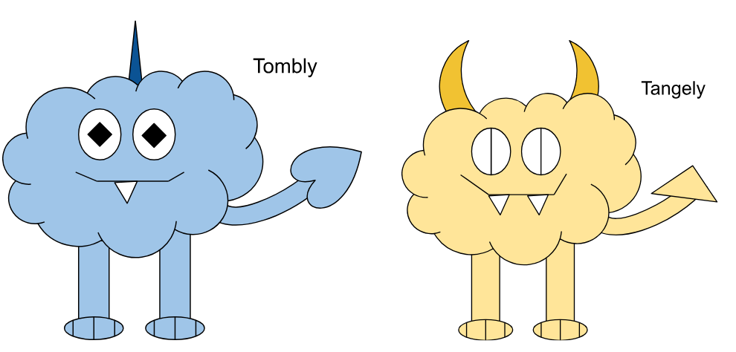
Activity Time

Slide 6
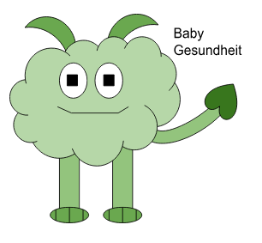
Why does Baby Gesundheit have two horns?
Think:
Did Galoo have two horns as a kid?
What does it mean to Acquire something? Can you think of any synonyms for Acquire?
Think about traits you Inherited from your parents versus traits you Acquired.
Notes:
Have students share their theories on why baby Gesundheit has two horns. A few prompt questions are on the slideshow, but you do not have to answer them.
When students have converged on an answer, move onto next slide to reinforce / course correct

Slide 7
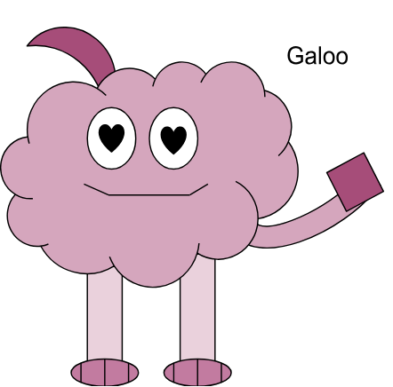
Why does Baby Gesundheit have two horns?
Galoo only has one horn because it fell off its bicycle and broke one. Having one horn is a trait it Acquired.
While you have many traits you Inherit from your parents at birth, some traits are things you learn or collect over time. Traits that are acquired are not given to kids!
Notes:
Many traits are inherited from parents. In the worksheet, some of the inherited traits include color, tail shape, number of teeth and more. Horn number is also inherited, but Galoo did not pass having one horn down to its kid.
The important thing to note here is why Galoo only has one horn. It used to have two, and then fell off its bike and lost one! This is supposed to represent other forms of injuries. Traits gained over time, such as injuries or things you learn, like language or how to ride a bike are not inherited. Traits that aren’t inherited can not be passed on. Galoo having one horn is a trait she inherited, and thus its kid did not inherit it, but instead inherited the trait she inherited, having two horns.

Slide 8
Heritable or Acquired - Group Discussion
Inherited
Acquired
Hair Color
Freckles
Language
Height
Scars
Nose Shape
Notes:
In humans, which traits are heritable and which are acquirable? Help your students have a discussion. You can grab the boxes and move them around
Some traits might be both
Answers:
Inherited:
- Hair Color: mostly genetic but environmental factors can affect it, sun may lighten it, you can dye it, etc. Could be both?
Nose Shape: This is genetic
Freckles: This is genetic, sun can make it more prominent though
Acquired:
Language: you learn a language
Scars: you aren’t born with these, you get them after injuries!
Both:
Height: Height is very middle ground, your parents heights influence how tall you can be but how tall you end up being also factors in things like diet

Slide 9

Note To Teachers
Delete this Slide Before Use
The following slides are designed to be used to help clear up any confusion students may have or to give extra practice to concepts as needed. They might not all be needed.
Image by Gustavo Ferreira Gustavo via Pixabay

Slide 10
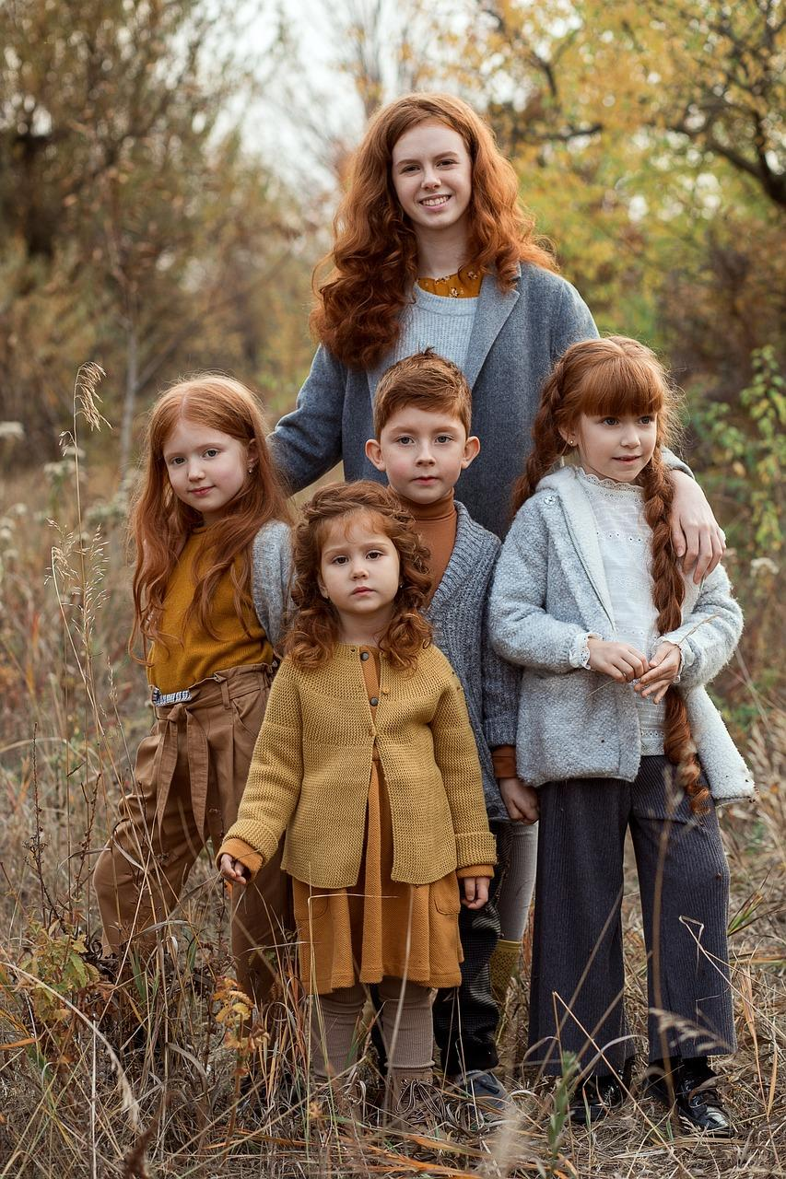
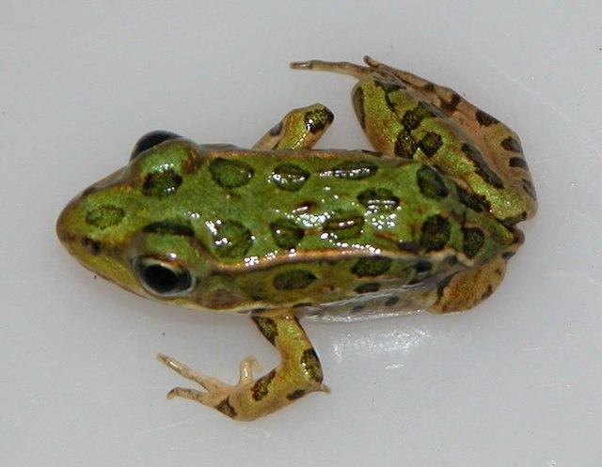
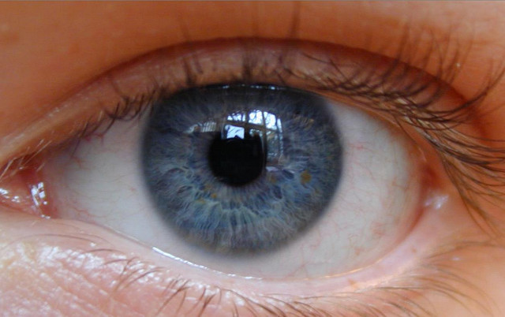
Think then Share – Defining terms
Trait
Acquired
Inherited
Notes:
Its recommended at this point that the students are given a minute or two of individual time to define these terms for themselves, either mentally or by writing them down somewhere. After a few minutes to think, start fielding a class discussion on the definition of these words.
“Deep Blue eye” by Flickr Upload Botl. Licensed under CC 2.0 via Wikimedia Commons - https://commons.wikimedia.org/wiki/File:Deep_Blue_eye.jpg
“Northern leopard frog with missing limb” by U.S. Fish and Wildlife Service Headquarters. Licensed under Public Domain via Wikimedia Commons - https://commons.wikimedia.org/wiki/File:Northern_leopard_frog_with_missing_limb._(10820607003).jpg
“Siblings Family Portrait Love Care” by Liliya Arslanova. Licensed under Pixabay Content license - https://pixabay.com/photos/siblings-family-portrait-love-care-7103506/

Slide 11
What does it mean?
Trait
Acquired
Inherited
Feature of a living thing
Can vary between members of a species or be consistent
Examples: Number of toes
Color of fur
Gained. The result of learning, diet, injury etc.
Acquired traits aren’t from parents, and aren’t passed on to kids
Examples:
Large muscles
Dyed hair
Received from relatives
Inherited traits are passed down from parents to children
Not always visible at birth
Examples:
Fur color
Color blindness
Notes:
A trait is a characteristic of a living thing! Basically everything is a trait. How many toes? A trait. Color? A trait. Traits are inherited due to distinct units of our DNA, called genes. A gene is like an instruction made of DNA that tells your body how to make a protein. (Proteins do most things around your body!)
Many traits are actually controlled by multiple genes, which is what can make it seem like traits of parents blend together. Many traits are fairly constant. Most humans have two eyes and grow hair on their head and stand on two feet and have elbows etc, but some are more variable.
Traits are often inherited, which means they are passed down from parent to child. Inherited traits are encoded in DNA, and can thus be passed down.
Traits can also be acquired, if someone does weightlifting and has a lot of muscle. But acquired traits will not be passed down. The muscular parent will not have a super muscular baby. Acquired traits are often something that you aren’t born with (though some inherited traits don’t show up until later (example: male pattern baldness), and you can be born with acquired traits (ex: many birth defects).
“Deep Blue eye” by Flickr Upload Botl. Licensed under CC 2.0 via Wikimedia Commons - https://commons.wikimedia.org/wiki/File:Deep_Blue_eye.jpg
“Northern leopard frog with missing limb” by U.S. Fish and Wildlife Service Headquarters. Licensed under Public Domain via Wikimedia Commons - https://commons.wikimedia.org/wiki/File:Northern_leopard_frog_with_missing_limb._(10820607003).jpg
“Siblings Family Portrait Love Care” by Liliya Arslanova. Licensed under Pixabay Content license - https://pixabay.com/photos/siblings-family-portrait-love-care-7103506/

Slide 12
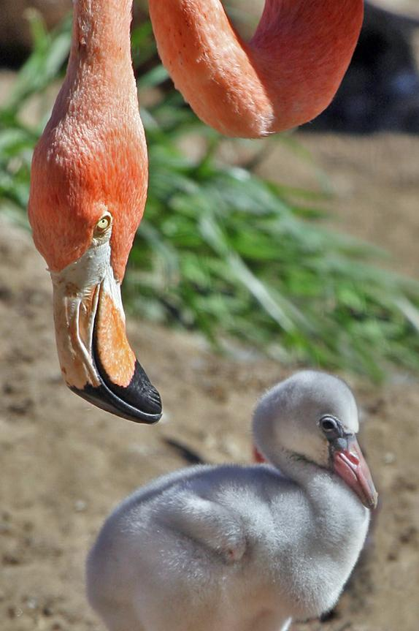
Traits can Change!
Traits are not all a constant thing; many traits can shift over time, and can be influenced by the environment.
Can you think of any traits you have that have changed?
Why do some traits change and others tend not to?
Notes:
Traits can change over time! For example, baby flamingos are born white, but when they grow up they don’t just become pink. Flamingos are only pink because they eat shrimp and algae full of a molecule called a carotenoid, which is a red pigment (it’s why carrots are orange!). If a flamingo lives in a place without carotenoids to eat, it would be grey!
Diet is a big factor in acquired traits, eating healthy food can help someone grow tall, but not eating enough vitamins (or too many!) can make someone sick. Injuries, training and things you are taught are also not inherited. Many adults know how to drive a car but kids don’t because knowledge isn’t (generally) inherited. (Some basic instincts are inherited but this is usually basic things like “Be quiet when there are big aerial predators circling over head so you, a baby, don’t get eaten by a hawk”)
Bonus fun fact: Humans can also turn orange if they eat too many carotenoids. It’s most common in infants but an adult can also have Carotenosis by eating something like 10 carrots a day for several weeks. Carotenosis is pretty much harmless but can be a symptom of certain digestive diseases.
“Flamingo and offspring” by Steve. Licensed under CC BY-SA 2.0 via Wikimedia Commons - https://commons.wikimedia.org/wiki/File:Flamingo_and_offspring.jpg

Slide 13
Go Beyond - Why do inherited traits often look like they blend?
Many inherited traits are not controlled by just one switch
Most are controlled by several, which are all inherited randomly from each parent
Can you think of any other ways inherited traits may be more complicated than in this activity?
Notes:
Are your students cruising through this concept? Want more? Use this slide
Most traits are controlled by more than one gene, and thus do not undergo simple mendelian inheritance like in Monster Mixer. Most traits are controlled by at least two, and sometimes up to dozens of genes. Because most if not all of these genes are inherited separately and randomly, it often looks like traits blend. A good way to think about this is to imagine a room in which there are multiple light switches, the more that are on the brighter the room becomes, but you can flip them on and off in any way. The brightness of the room would look more like a gradient!
Have students discuss the question on the slide as class. If no one knows, that’s completely fine!
Discussion prompts: Does anyone know what dominant and recessive mean?
Traits are also not inherited from just one parent or the other, but actually from both! You actually have two copies of each trait, one from each parent. Which one each parent gives their offspring is random* though. These traits are called alleles. How the alleles are expressed is a little complicated, often times one is dominant over the other, and so the dominant one will be expressed. Sometimes both are expressed simultaneously, either by blending (ex: a red flower and white flower make a pink flower), which is called incomplete dominance, or in different domains (ex: a red flower and a white flower make a flower with red and white splotches), which is called codominance.
Another way genes can be more complicated than what was modelled in Monster Mixer is that many traits have more than just two versions (alleles). A real life example of this is blood types. There are 3 versions of the blood type gene, A, B and O. A and B can occur simultaneously to make AB blood, O is recessive to A and B, meaning if you get an A and an O from each of your parents, you will be type A.
Some traits also are genetic and environmental. Height is one of these!
* It’s not 100% random all of the time but explaining linked genes and recombination and sex chromosomes is out of the scope of this lesson plan, even for advanced students. Because those are high school or collegiate level genetics topics.

Slide 14
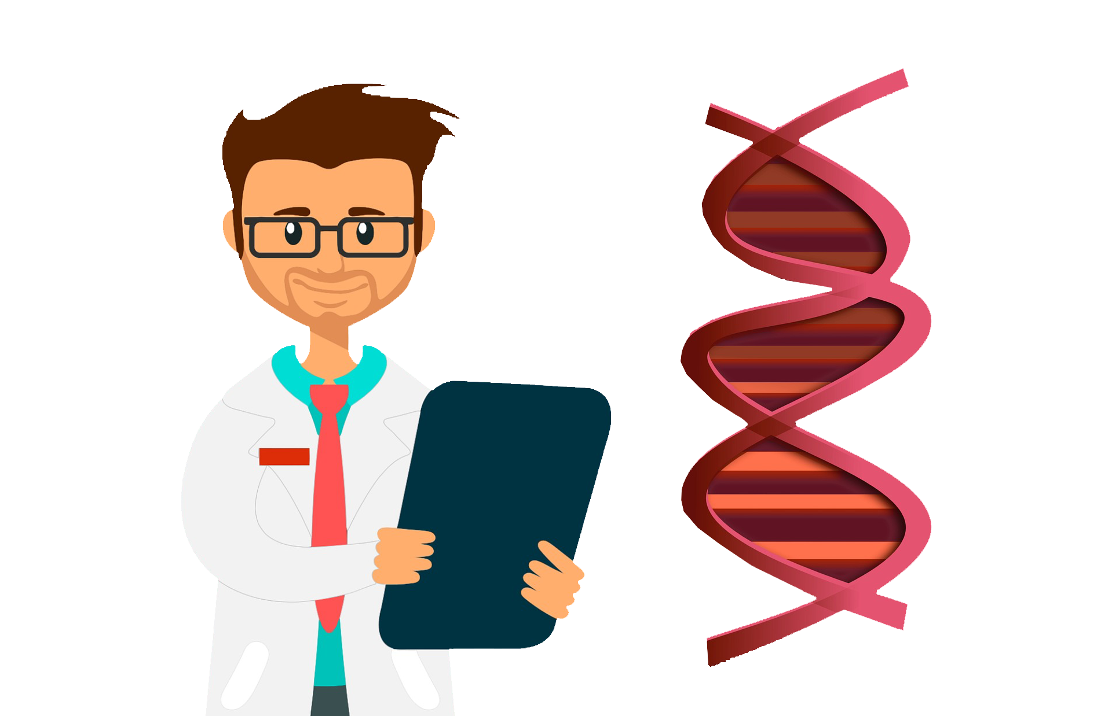
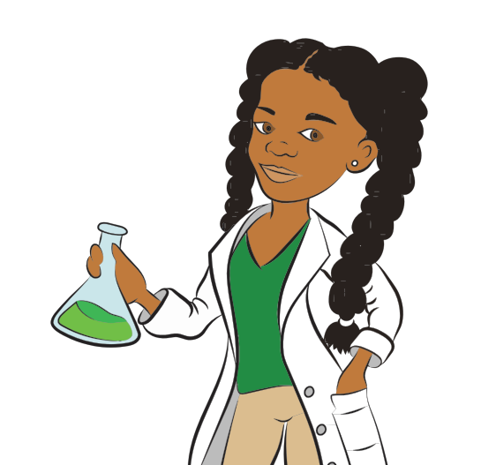
How are Traits Inherited?
Illustrations by Mohamed Hassan and GDJ via Pixabay

Slide 15
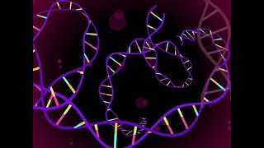
What is DNA?
Notes:
https://www.youtube.com/watch?v=_xjdmj_iKhs
You can stop the video at 3:20 if you would like to save time, the back half of the video is a bit more complicated than this lesson requires.

Slide 16
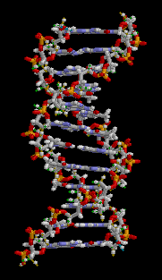
What is DNA?
DNA is unique to every living thing, and found inside of nearly every type of cell in the body
DNA is the recipe book to make all of the proteins an organism needs to grow, live, and reproduce
Notes:
All living things have DNA, as it acts as the recipe book of life. The information it carries is used by every organism to grow, live, and reproduce.
DNA is an acronym for Deoxyribonucleic acid. Each organism inherits a mix of their parents’ DNA, with different bundles of DNA, called chromosomes, being inherited separately. DNA takes the form of a double helix, which is sort of like if a ladder was twisted. The backbone of the DNA is there to hold the “rungs” together, with the rungs carrying the information.
“DNA animation” by brian0918. Licensed under Public Domain via Wikimedia Commons - https://commons.wikimedia.org/wiki/File:DNA_animation.gif

Slide 17
How does DNA hold information?
DNA stores its information in its 4 bases, which are called Cytosine, Guanine, Adenine and Thymine
Thousands of bases line up to form a gene, which usually makes one protein
Bases are read in groups of 3 at a time to make a protein. These groups are called codons
Each codon codes for the next ingredient of the protein the gene makes
Codon
Base
Notes:
DNA’s information is stored in the “rungs of the ladder”, the bases. There are 4 bases, Cytosine, Guanine, Adenine and Thymine, which are commonly referred to with their first letter. Hundreds to thousands of bases are lined up in a row to create a gene. A gene is a part of the DNA that codes for a protein.
Not all of the DNA in your genome codes for proteins, large sections of it exist to regulate protein coding regions, provide structure, or for reasons scientists still don’t know. The bases are read by the cell in groups of 3, called codons. Codons are read by the cell to tell it what the next building block (amino acid) of a protein that is being built should be. If bases are like letters, codons are like words! String enough words, or codons together, and you can make a protein / sentence!
With 4 bases to choose from, and 3 bases per codon, there are 64 possible options for what a codon could mean! However, there are only 20 building blocks for protein, so there is repetition.

Slide 18
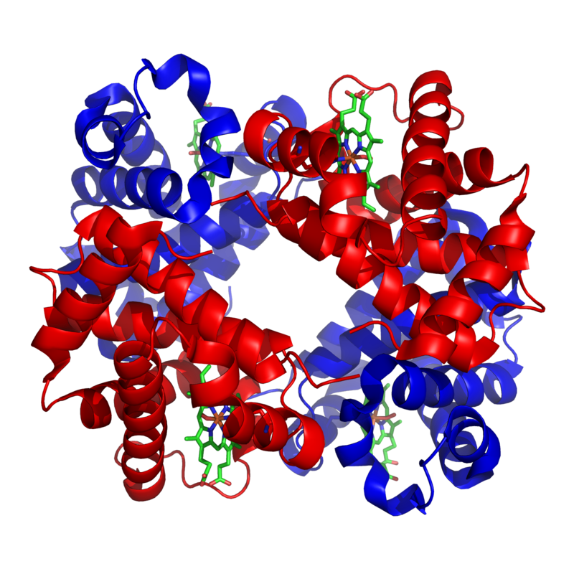
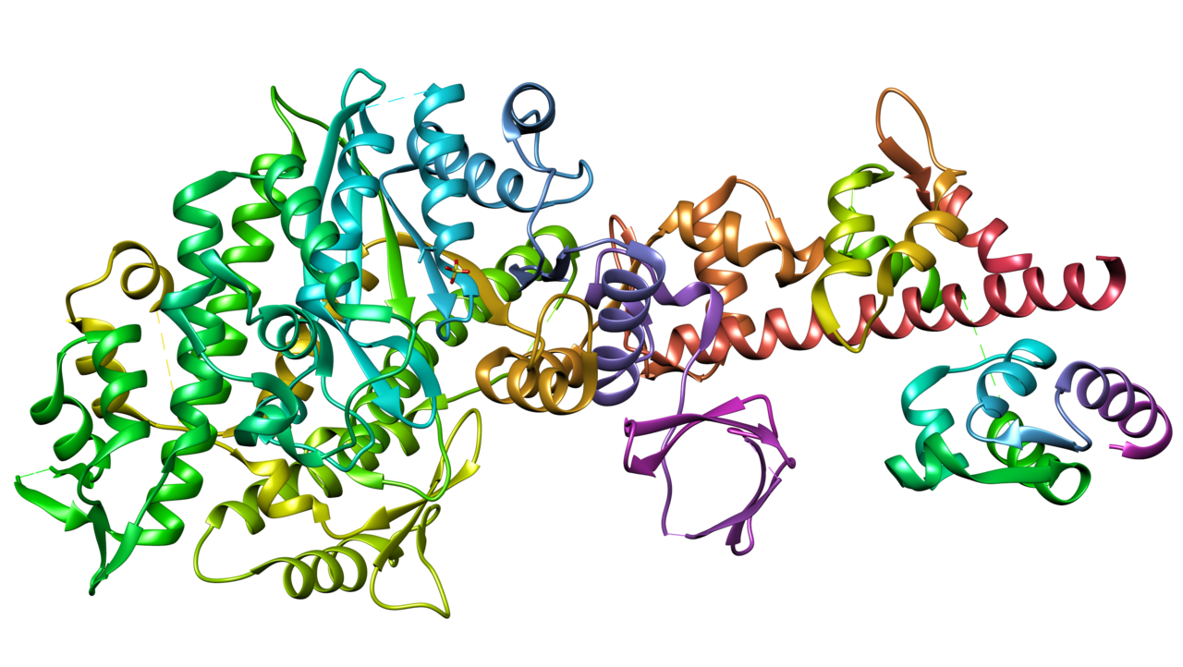
Why are proteins important?
Proteins are the tools of the body, performing many functions around the body, from carrying nutrients, contracting muscles, forming structures, fighting disease, and more.
Hemoglobin, which lets red blood cells carry oxygen —>
<— Myosin, which helps contract your muscles
Notes:
While students have likely heard of protein as an essential nutrient, proteins are also the building blocks of life. They are made up of hundreds of small parts, called amino acids. DNA codes the order of amino acids, and in turn, codes for the different proteins our bodies build. The different instructions create different shaped proteins, which have different functions.
There are thousands of proteins; just two are shown here. Proteins make up everything, from your hair, to your eyes, to your blood and muscles.
“Haemoglobin” by Zephyris. Licensed under CC BY-SA 3.0 via Wikimedia Commons - https://commons.wikimedia.org/wiki/File:1GZX_Haemoglobin.png
“Myosin V” by MarinaVladivostok. Licensed under CC BY-SA 1.0 via Wikimedia Commons - https://commons.wikimedia.org/wiki/File:Myosin_V.png

Slide 19
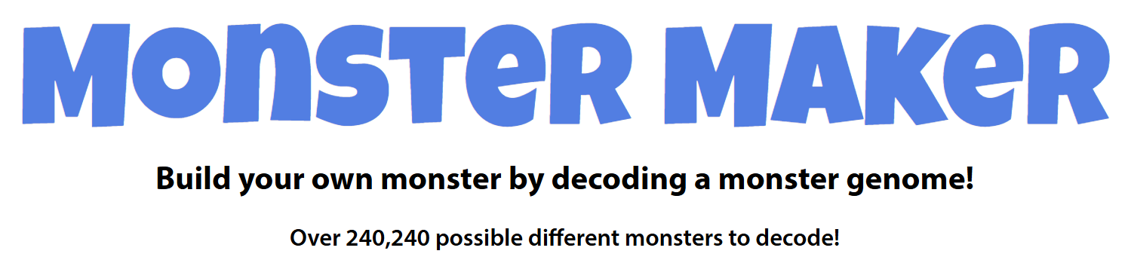
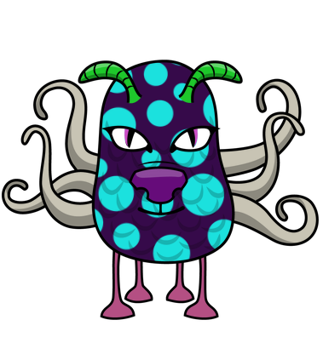
Game Time
https://askabiologist.asu.edu/games-sims/monster-maker-game
Notes:
Monster maker is a game in which students can explore how codons (or different color beads in the game) can code instructions to make traits.
https://askabiologist.asu.edu/monster-story
https://askabiologist.asu.edu/games-sims/monster-maker-game

Slide 20
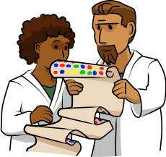
Discussion
What parts of the game do you think are similar to how DNA works? What parts do you think are different?
Why do you think the letters came from groups of 3 circles? What do you think that represents?
What did the different colors/patterns represent?
How are traits passed down from generation to generation?
Notes:
Bring students back from game and have a class discussion on what it is they just played. Why is the game relevant to what they just learned? What connections can they make? What do they not understand?

Slide 21

Test Your Knowledge
On your whiteboard, define the following terms:
Trait Acquired
Inherited DNA
Notes:
As mentioned in lesson plan, students should have been asked early on to keep track of the words, “Trait”, “Inherited”, and “Acquired,”. Give them a few minutes to work with their group to refine a definition for each of those words and to add a definition for “DNA”.
Illustration by u_fg0tkeqgiy via Pixabay

Slide 22
Test Your Knowledge
Pair up with another group and help them improve their definitions.
Trait Acquired
Inherited DNA
Notes:
After a few minutes, have students rotate groups and work with a new group to refine their definitions. Give the new groups a few minutes to do that.
Then either go around and have each group share their definitions (there are 4 words and likely 4 people per table group, which would be a recommended way to distribute the sharing) or have the students turn in their definitions.
Illustration by u_fg0tkeqgiy via Pixabay

Slide 23
Image Attributions
Slide 2
“A litter of kittens suckling their mother” by Laitche- Own Work. Licensed under Public Domain via Wikimedia Commons - https://commons.wikimedia.org/wiki/File:Laitche-P013.jpg
“Obama family portrait in the Green Room” by Annie Leibovitz / Released by White House Photo Office. Licensed under Public Domain via Wikimedia Commons - https://commons.wikimedia.org/wiki/File:Obama_family_portrait_in_the_Green_Room.jpg
Slide 3
“Crowd of people crowd football fans” by KeithJJ. Licensed under Pixabay Content license - https://pixabay.com/photos/crowd-of-people-crowd-football-fans-1488213/
Slide 4
“Snow pea flowers” by Bmdavll. Licensed under CC BY-SA 4.0 via Wikimedia Commons - https://commons.wikimedia.org/wiki/File:Snow_pea_flowers.jpg
Slide 7
Image by Gustavo Ferreira Gustavo via Pixabay

Slide 24
Image Attributions
Slide 8
“Deep Blue eye” by Flickr Upload Botl. Licensed under CC 2.0 via Wikimedia Commons - https://commons.wikimedia.org/wiki/File:Deep_Blue_eye.jpg
“Northern leopard frog with missing limb” by U.S. Fish and Wildlife Service Headquarters. Licensed under Public Domain via Wikimedia Commons - https://commons.wikimedia.org/wiki/File:Northern_leopard_frog_with_missing_limb._(10820607003).jpg
“Siblings Family Portrait Love Care” by Liliya Arslanova. Licensed under Pixabay Content license - https://pixabay.com/photos/siblings-family-portrait-love-care-7103506/
Slide 10
“Flamingo and offspring” by Steve. Licensed under CC BY-SA 2.0 via Wikimedia Commons - https://commons.wikimedia.org/wiki/File:Flamingo_and_offspring.jpg
Slide 12
Illustrations by Mohamed Hassan and GDJ via Pixabay
Slide 14
“DNA animation” by brian0918. Licensed under Public Domain via Wikimedia Commons - https://commons.wikimedia.org/wiki/File:DNA_animation.gif

Slide 25
Image Attributions
Slide 16
“Haemoglobin” by Zephyris. Licensed under CC BY-SA 3.0 via Wikimedia Commons - https://commons.wikimedia.org/wiki/File:1GZX_Haemoglobin.png
“Myosin V” by MarinaVladivostok. Licensed under CC BY-SA 1.0 via Wikimedia Commons - https://commons.wikimedia.org/wiki/File:Myosin_V.png
Slide 19
Illustration by u_fg0tkeqgiy via Pixabay

