Slide 1
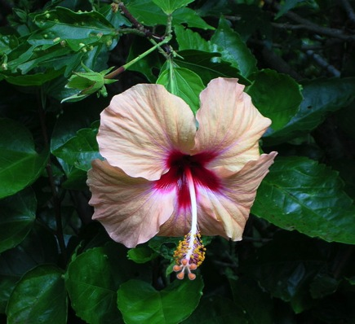
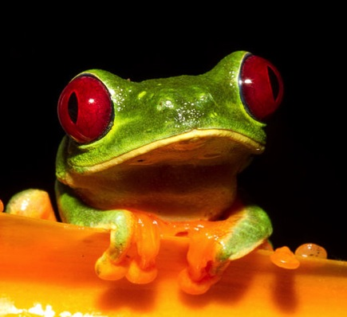
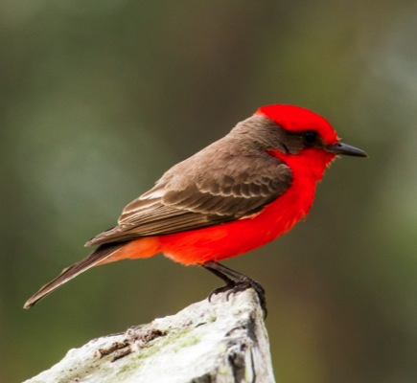
Adaptation via Natural Selection
**Take your pre-test before we begin**
Notes:
Hibiscus by Forest & Kim Starr
https://commons.wikimedia.org/wiki/File:Starr_050107-2956_Hibiscus_rosa-sinensis.jpg
Red-eyed treefrog by Brian Gratwicke
https://commons.wikimedia.org/wiki/File:Red-eyed_Treefrog_(Agalychnis_callidryas).jpg
Vermillion flycatcher by James Diedrick
https://commons.wikimedia.org/wiki/File:Vermillion_Flycatcher.jpg

Slide 2
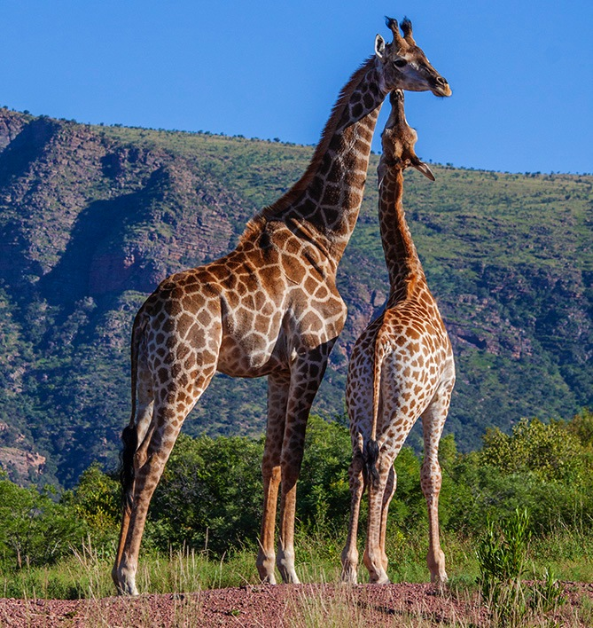
How is a trait passed to an organism's offspring?
Is having a long neck good or bad?
Notes:
A female giraffe walks up to a tree with leaves just out of reach. She lifts her head and stretches her long neck, barely reaching the green leaves of the tree. As she eats more and more leaves off of tall trees, her neck seems to have grown a little bit longer. This giraffes is pregnant with a baby giraffe. When the baby grows to be full size, will it have a longer neck because the mother giraffe stretched so much?
Let students come up with a consensus for this part
"Giraffe interaction" by Hein waschefort - Own work. Licensed under CC BY-SA 3.0 via Wikimedia Commons - https://commons.wikimedia.org/wiki/File:Giraffe_interaction.jpg#/media/File:Giraffe_interaction.jpg

Slide 3
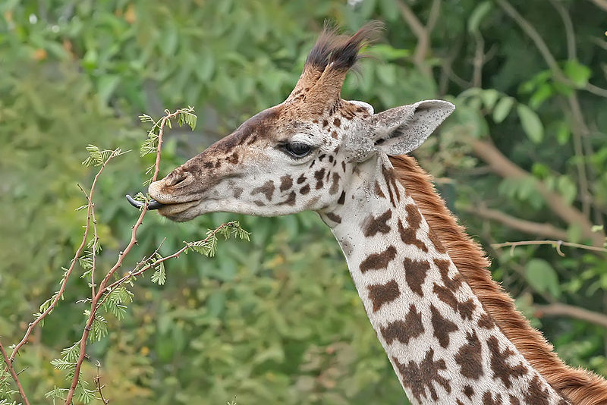
Talk time
A pregnant giraffe stretches her long neck to reach the green leaves of a tree. When the baby grows up, will it have a longer neck because its mother stretched so much?
Notes:
Again, let students come to an answer on their own, even if it is wrong.
Giraffe feeding by Muhammad Mahdi Karim (www.micro2macro.net) https://commons.wikimedia.org/wiki/File:Giraffe_feeding,_Tanzania_crop.jpg

Slide 4
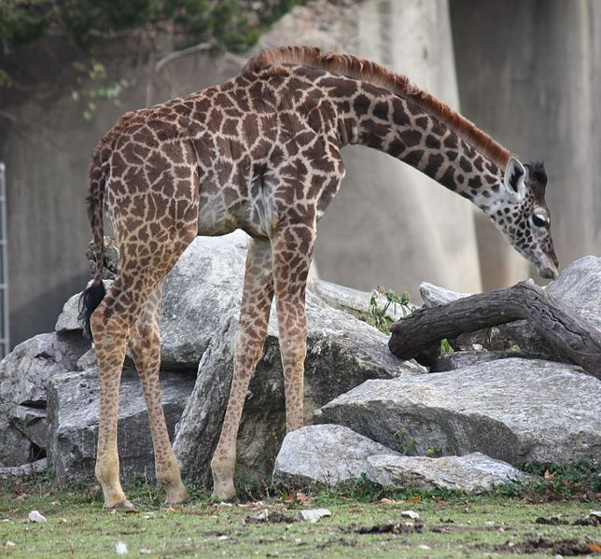
Talk Time
Imagine two pairs of giraffes:
A male and female that only eat from the tops of tall trees.
A male and female that only eat from lower branches.
If each pair has a baby
giraffe, which baby will
have a longer neck?
Notes:
Let students come to their own consensus.
Baby giraffe by Ltshears; https://commons.wikimedia.org/wiki/File:BabyMasaiGiraffe1.jpg

Slide 5
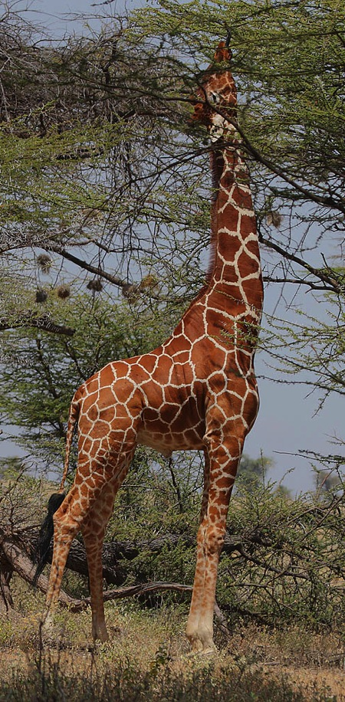
Questions (answer one individually in worksheet)
How did giraffes get such a long neck?
Will giraffe babies be similar to their parents? Why?
How are traits, such as a long neck, passed from parents to offspring?
Notes:
"Flickr - Rainbirder - High-rise living" by Steve Garvie from Dunfermline, Fife, Scotland - High-rise living. Licensed under CC BY-SA 2.0 via Wikimedia Commons - https://commons.wikimedia.org/wiki/File:Flickr_-_Rainbirder_-_High-rise_living.jpg#/media/File:Flickr_-_Rainbirder_-_High-rise_living.jpg

Slide 6
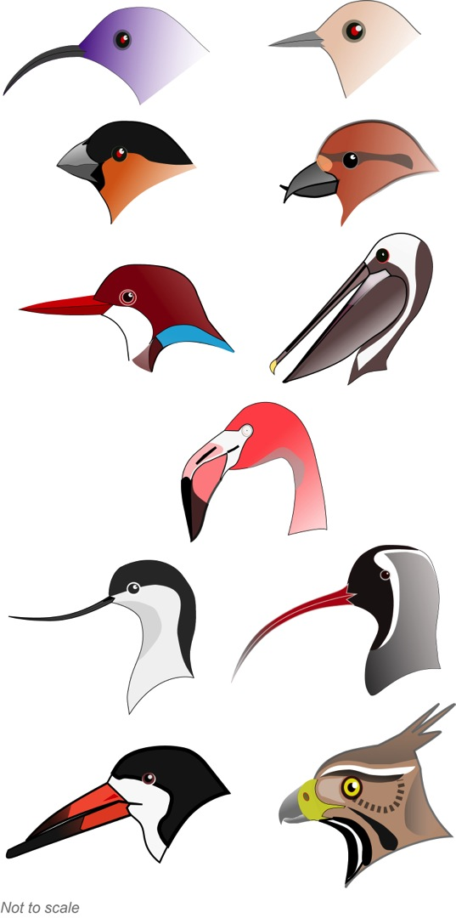
Talk Time
How might these ideas apply to birds with beaks of different sizes and shapes?
Notes:
Feeding types, from left to right, moving down are 1) Nectar feeder; 2) Insectivore; 3) Granivore; 4) Specialist seed eater; 5) Fishing; 6) Netting (pelican); 7) Filter feeder (flamingo); 8) surface probing; 9) probing; 10) surface skimming; 11) raptor (meat eating)
Again, do not interfere with student discussion, just make sure to help it continue; do not correct them if they get it wrong here.
Bird beak diagram modified from Shyamal (original) and Jeff Dahl.
https://commons.wikimedia.org/wiki/File:BirdBeaks_named.svg

Slide 7
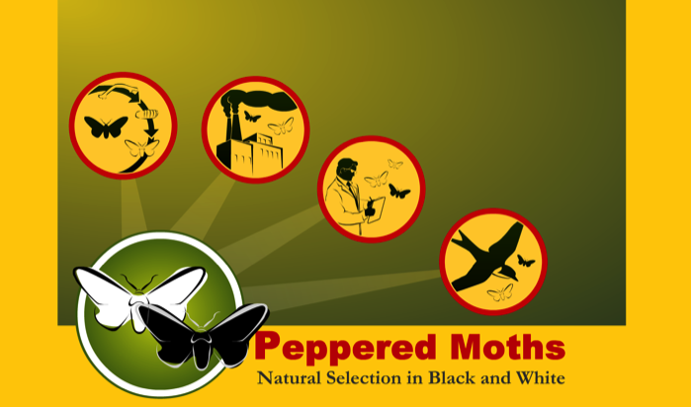
Activity Time
If using the peppered moth activity,
skip the next slide!
Notes:
https://commons.wikimedia.org/wiki/File:Computer-aj_aj_ashton_01.svg

Slide 8
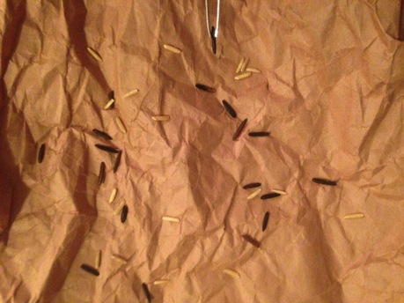
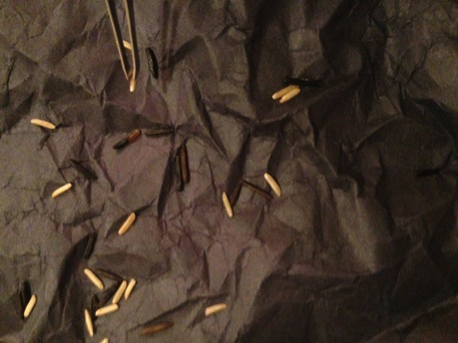
Explore Rice Hunting Activity
Follow the directions
Don’t forget: repeat with each paper color 3x
Record in your worksheets
Notes:
These are examples of white bark vs. sooty bark; similar to environment of the peppered moth before and during industrial revolution

Slide 9
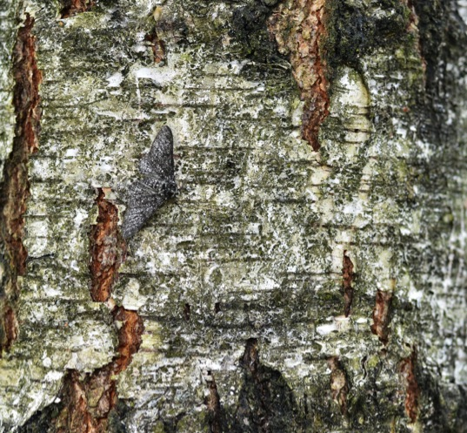
Talk Time
What changes did you observe in the rice or moth population? Why did this happen?
What would happen if we colored the rice or moths to be more camouflaged? In the wild, would the next generation change color too?
Notes:
Let students come up with answers; they should be aligning more with natural selection at this point rather than Lamarckian inheritance.
Biston betularia by Gilles San Martin
https://commons.wikimedia.org/wiki/File:Biston_betularia_20110529_102239_8073M.JPG

Slide 10
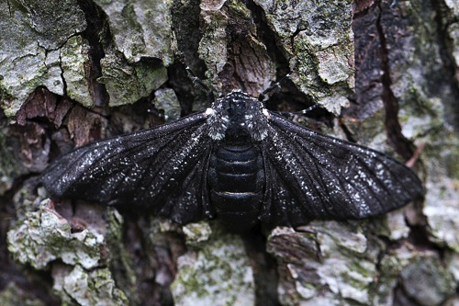
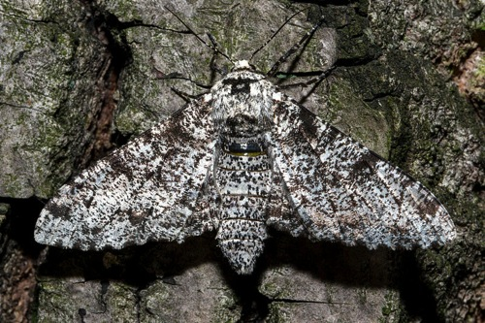
Listen and Talk
Discuss Lamarck’s and Darwin's ideas. Which theory drives the appearance of adaptations?
If no dark morph had existed in the rice or moths, what could have happened?
If more changes affected one population of rice or moths over time, might they become different enough to be a new species?
Notes:
Jean-Baptiste Lamarck thought that traits gained by an organism during it’s lifetime (increased strength, stretched neck, etc.) would be passed on to offspring and this is how a trait spread through a population.
Charles Darwin proposed natural selection. Organisms with mutations that are more beneficial (e.g., longer giraffe neck allows access to more food) will be more likely to pass on their genes to the next generation. If more mutations for even longer necks appear and these are also beneficial, these genes will be passed on and spread through the population over many generations.
Let the students discuss these questions, but provide answers if they have a hard time.
The population could have had a hard time bouncing back if the light morphs were captured frequently. This could have led to extinction of the species… or, if you want to introduce the idea of a bottleneck effect to students, this is a good time to do so.
Eventually, this could happen. Just make it clear that they would need to acquire many different mutations and that this would take a long time (evolution of multicellular organisms occurs over thousands or millions of years, usually)
Both Biston betularia by Jerzy Strzelecki
https://commons.wikimedia.org/wiki/File:Biston_betularia(js)02_Lodz(Poland).jpg
https://commons.wikimedia.org/wiki/File:Biston_betularia(js)01_Lodz(Poland).jpg

Slide 11
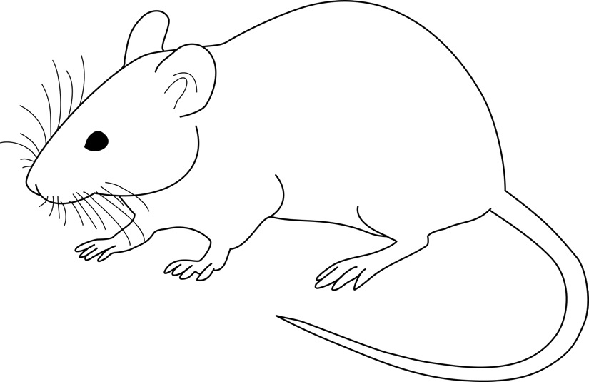
Talk Time
Weismann cut the tails off of many generations of mice, bred them, and observed what their offspring looked like. What do you think he found? Does this support Lamarck or Darwin’s ideas?
Notes:
Let the students discuss these questions and come up with their own answers; make sure to guide them to the correct answer if they are going astray
Weismann found that even though he cut tails off of parent mice, later children of those parents did not have short tails. This evidence does not support Lamarckian inheritance. If Lamarck was right, changes in parent mice should have been visible in the offspring.
Rat line drawing by Gwilz
https://commons.wikimedia.org/wiki/File:Vector_diagram_of_laboratory_mouse_(black_and_white).svg

Slide 12
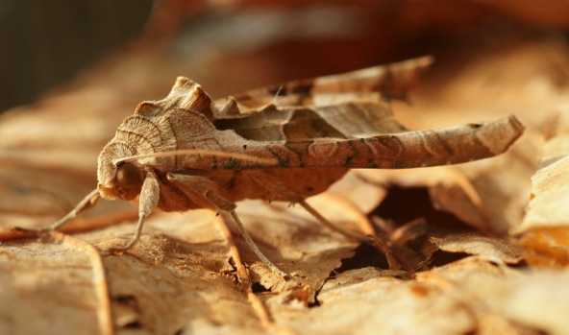
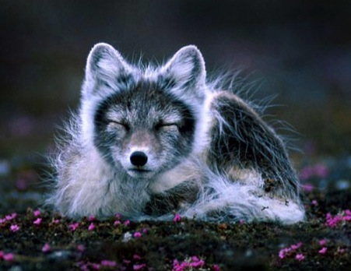
Talk Time
How can a trait benefit an individual?
What does "survival of the fittest" mean?
How does an adaptation begin?
How does a trait spread within a population?
What factors might cause some animals to survive while others don't?
Notes:
Anything that helps an animal to survive and reproduce so that its genes are passed to the next generation can benefit an individual. This can be coloration, camouflage, muscle composition for speed, beak shape or mouth size for ability to eat certain foods, etc.
Survival of the fittest has a relative meaning. Here, “fit” does not necessarily mean stronger or faster. Fit means well adapted to your environment. If the fastest arctic fox in a population doesn’t grow its white fur in the right season (to camouflage it during winter and help it be more successful at hunting and avoiding predators), it isn’t considered “fit” and will likely not survive as long or not have as many offspring as foxes that grow white fur before winter.
Adaptations are based off of random mutations. Genes mutate and produce specific traits. If these traits are beneficial in a specific environment, they may spread through the population over time (many, many generations)
If a trait is in an individual that is more successful at breeding, the genes for that trait will more likely spread through the population.
Health, living in the right environment, hatching or being born at the right time, etc.
"Phlogophora meticulosa, Achateule 1" by Böhringer Friedrich - Own work. Licensed under CC BY-SA 2.5 via Wikimedia Commons - https://commons.wikimedia.org/wiki/File:Phlogophora_meticulosa,_Achateule_1.JPG#/media/File:Phlogophora_meticulosa,_Achateule_1.JPG
"Fjellrev pho" by Mr. Per Harald Olsen – User Perhols on no.wikipedia - no.wikipedia. Licensed under CC BY-SA 3.0 via Wikimedia Commons - https://commons.wikimedia.org/wiki/File:Fjellrev_pho.jpg#/media/File:Fjellrev_pho.jpg

Slide 13
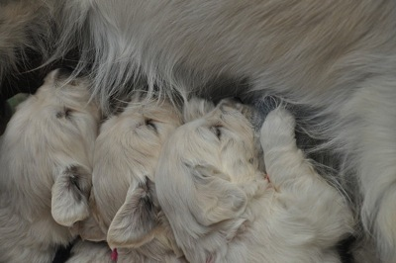
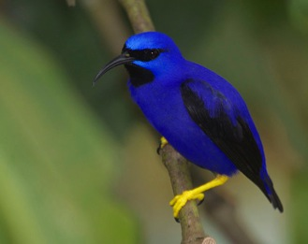
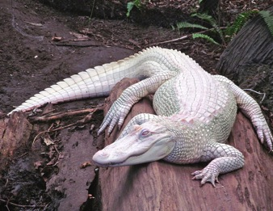
Talk and Listen
Define:
Fitness
Adaptation
Natural selection
Heritability
Mutation
Notes:
-Remind students that fitness is related to the ability to reproduce more, not exercise fitness
-A good example of adaptation is in bird beaks, such as this purple honeycreeper that has a beak specialized for certain flowers
-Mutations can be good or bad; here, we see an albino alligator. In the wild, this animal would have a hard time surviving (as a juvenile) because it could easily be eaten. Once an adult, the albino color mutation would make it harder for it to sneak up on prey, so it would have a hard time surviving as an adult as well.
Golden retriever puppes by Koosg.
https://commons.wikimedia.org/wiki/File:Golden_retriever_puppies_4_wk.jpg
Purple Honeycreeper by Gregory “Slobirdr” Smith
https://commons.wikimedia.org/wiki/File:Purple_Honeycreeper_(Cyanerpes_caeruleus)_(13962727398).jpg
"Rico - Albino Alligator" by Sherrif2966 - Own work. Licensed under CC BY-SA 4.0 via Wikimedia Commons - https://commons.wikimedia.org/wiki/File:Rico_-_Albino_Alligator.jpg#/media/File:Rico_-_Albino_Alligator.jpg

Slide 14
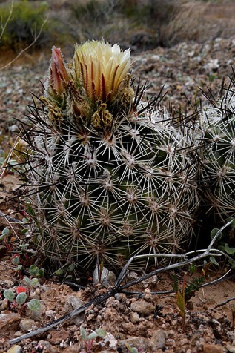
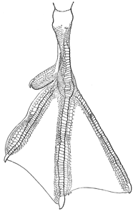
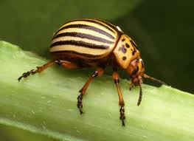
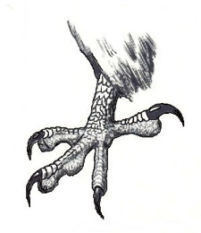
Talk and Listen
1. How do these ideas apply to other examples of adaptations? (Bird feet, cacti, and insect pests?)
2. What are some human adaptations and how do they increase our reproductive success (fitness) in the context of our habitat?
Notes:
Clawed feet: "Circaetus gallicus claw" by Original uploader was Emlok at pl.wikipedia - Originally from pl.wikipedia; description page is/was here.. Licensed under CC BY-SA 3.0 via Wikimedia Commons - https://commons.wikimedia.org/wiki/File:Circaetus_gallicus_claw.jpg#/media/File:Circaetus_gallicus_claw.jpg
Webbed foot and Colorado Potato beetle under public domain.
Pincushion cactus: https://commons.wikimedia.org/wiki/File:Siler_pincushion_cactus_(Pediocactus_sileri)_(6307401470).jpg by USFWS Mountain-Prairie

Slide 15
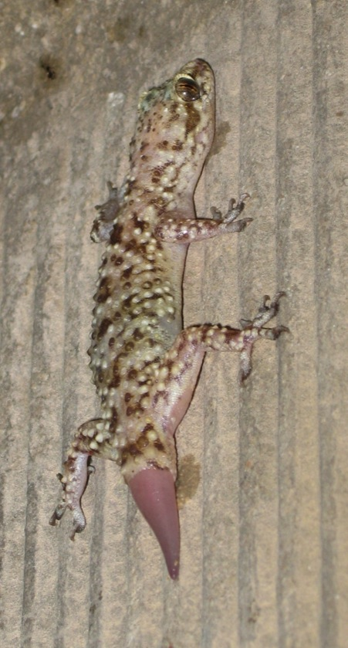
Last Steps
Take post-test (says POST in upper left corner)
Discuss potential homework extension
Notes:
Geckos have some really interesting adaptations. First, the structure of their toes lets most of them climb trees, walls, or other smooth structures very easily. Many can also regenerate their tails. This allows them to lose their tails if they are being attacked, as the tail will pop off and move around like a worm, distracting most predators.
Gecko by FraKctured
https://commons.wikimedia.org/wiki/File:Gecko_regenerating_tail.jpg

Slide 16
Image Credits
Slide 1:
Hibiscus by Forest & Kim Starr (https://commons.wikimedia.org/wiki/File:Starr_050107-2956_Hibiscus_rosa-sinensis.jpg)
Red-eyed treefrog by Brian Gratwicke (https://commons.wikimedia.org/wiki/File:Red-eyed_Treefrog_(Agalychnis_callidryas).jpg)
Vermillion flycatcher by James Diedrick (https://commons.wikimedia.org/wiki/File:Vermillion_Flycatcher.jpg)
Slide 2:
"Giraffe interaction" by Hein waschefort - Own work. Licensed under CC BY-SA 3.0 via Wikimedia Commons - https://commons.wikimedia.org/wiki/File:Giraffe_interaction.jpg#/media/File:Giraffe_interaction.jpg
Slide 3:
Giraffe feeding by Muhammad Mahdi Karim (www.micro2macro.net) https://commons.wikimedia.org/wiki/File:Giraffe_feeding,_Tanzania_crop.jpg
Slide 4:
Baby giraffe by Ltshears (https://commons.wikimedia.org/wiki/File:BabyMasaiGiraffe1.jpg)
Slide 5:
"Flickr - Rainbirder - High-rise living" by Steve Garvie from Dunfermline, Fife, Scotland - High-rise living. Licensed under CC BY-SA 2.0 via Wikimedia Commons - https://commons.wikimedia.org/wiki/File:Flickr_-_Rainbirder_-_High-rise_living.jpg#/media/File:Flickr_-_Rainbirder_-_High-rise_living.jpg
Slide 6:
Bird beak diagram modified from Shyamal (original) and Jeff Dahl. (https://commons.wikimedia.org/wiki/File:BirdBeaks_named.svg)
Slide 7:
Computer (https://commons.wikimedia.org/wiki/File:Computer-aj_aj_ashton_01.svg)
Slide 9:
Biston betularia by Gilles San Martin (https://commons.wikimedia.org/wiki/File:Biston_betularia_20110529_102239_8073M.JPG)
Slide 10:
Both Biston betularia by Jerzy Strzelecki (https://commons.wikimedia.org/wiki/File:Biston_betularia(js)02_Lodz(Poland).jpg)
(https://commons.wikimedia.org/wiki/File:Biston_betularia(js)01_Lodz(Poland).jpg)

Slide 17
Image Credits (Continued)
Slide 11:
Rat line drawing by Gwilz (https://commons.wikimedia.org/wiki/File:Vector_diagram_of_laboratory_mouse_(black_and_white).svg)
Slide 12:
"Phlogophora meticulosa, Achateule 1" by Böhringer Friedrich - Own work. Licensed under CC BY-SA 2.5 via Wikimedia Commons – (https://commons.wikimedia.org/wiki/File:Phlogophora_meticulosa,_Achateule_1.JPG#/media/File:Phlogophora_meticulosa,_Achateule_1.JPG)
"Fjellrev pho" by Mr. Per Harald Olsen – User Perhols on no.wikipedia - no.wikipedia. Licensed under CC BY-SA 3.0 via Wikimedia Commons – (https://commons.wikimedia.org/wiki/File:Fjellrev_pho.jpg#/media/File:Fjellrev_pho.jpg)
Slide 13:
Golden retriever puppes by Koosg. (https://commons.wikimedia.org/wiki/File:Golden_retriever_puppies_4_wk.jpg)
Purple Honeycreeper by Gregory “Slobirdr” Smith (https://commons.wikimedia.org/wiki/File:Purple_Honeycreeper_(Cyanerpes_caeruleus)_(13962727398).jpg)
"Rico - Albino Alligator" by Sherrif2966 - Own work. Licensed under CC BY-SA 4.0 via Wikimedia Commons - https://commons.wikimedia.org/wiki/File:Rico_-_Albino_Alligator.jpg#/media/File:Rico_-_Albino_Alligator.jpg
Slide 14:
Clawed feet: "Circaetus gallicus claw" by Original uploader was Emlok at pl.wikipedia - Originally from pl.wikipedia; description page is/was here.. Licensed under CC BY-SA 3.0 via Wikimedia Commons - https://commons.wikimedia.org/wiki/File:Circaetus_gallicus_claw.jpg#/media/File:Circaetus_gallicus_claw.jpg
Webbed foot and Colorado Potato beetle under public domain.
Pincushion cactus: (https://commons.wikimedia.org/wiki/File:Siler_pincushion_cactus_(Pediocactus_sileri)_(6307401470).jpg) by USFWS Mountain-Prairie
Slide 15:
Gecko by FraKctured (https://commons.wikimedia.org/wiki/File:Gecko_regenerating_tail.jpg)

Slide 18
Common Misconceptions
Natural resources are not limited
Organisms do not compete to survive/reproduce; or if there is competition, the strongest always survives
There is no variation within a population; or if there is, it does not affect survival
When a trait is no longer beneficial, it will disappear
Traits acquired during lifetime will be inherited by offspring
Traits that are positively influenced by the environment will be passed on to offspring
Fitness = strength, speed, intelligence or longevity, and it is not environment (context)-dependent
Mutations occur to meet the needs of the population, and change entire population equally
Organisms can intentionally become a new species
Mutations are adaptive/intentional responses to the environment
Concept inventory from Anderson et al., JRST, 2002

